Slide 1
Functions

Slide 2
Return Statement
Returning control from function that does not return value: return;
Returning control from function that returns value: return <value>;
The return value could be any valid expression that returns a value:
a constant
a variable
a calculation, for instance (a + b) * c
call to another function that returns a value
The value must be of the same (or compatible) type that the function was defined. For example, an int function can’t return a float value.

Slide 3
How the return statement works?
First you need to understand how the function call works. When you call a function two things happen
The execution of the current function is paused.
The function that you call executes.
This is what we call a transfer of control. When you call a function the control of the program is transferred from the calling function to the called function.
The return statement returns the control to the previous routine. That function will continue its execution from the point where it was paused.
On the contrary, a function that calls the return statement is finished. It is not in a paused state and it cannot resume.

Slide 4
void main() { int sum = sumDigits(); printf("%d\n", sum); return; }
int sumDigits() { int sum = 0; int digit; for(digit = 0; digit <= 9; ++digit) { sum += digit; } return sum; }

Slide 5
The function main is called when our program is started. Then it calls the routine sumDigits. At this point “main” is paused and sumDigits starts. The second function will do its calculations and reach the return sum; statement. Here it ends and the control is transferred back in main. Since sumDigits returns a value(the value of the sum variable), a value will appear in the place where the function was called.
The sum of the digits is 0+1+2…+9= 45. This value will appear in the place of invocation and the variable sum will take this value. Then we print that value and return from the main function, which ends our program.

Slide 6
Type of Functions
1) Function with no argument and no Return value
2)Function with no argument and with Return value
3)Function with argument and No Return value
4)Function with argument and Return value
From the above, 1 and 3 types does not return any value when the function is called so, We use void return type while defining the function.
When we call the function 2 and 4 types will return some value so, We have to use the appropriate data type (int, float, double etc) as return type while defining the function. We use return keyword inside the function to return some value when the function is called from the main() function or any sub functions.

Slide 7
Function with no argument and no Return value
In this method, We won’t pass any arguments to the function while defining, declaring or calling the function. This type of functions will not return any value when we call the function from main() or any sub function. When we are not expecting any return value but, we need some statements to be printed as output then, this type of functions are very useful.
#include<stdio.h>
// Function Declaration
void Addition();
void main()
{
printf("\n ............. \n");
Addition();
}
void Addition()
{
int Sum, a = 10, b = 20;
Sum = a + b;
printf("\n Sum of a = %d and b = %d is = %d", a, b, Sum);
}

Slide 8
Function with no argument and with Return value
In this method, We won’t pass any arguments to the function while defining, declaring or calling the function. This type of functions will return some value when we call the function from main() or any sub function. Data Type of the return value will depend upon the return type of function declaration. For instance, if the return type is int then return value will be int.

Slide 9
Example
#include<stdio.h>
int Multiplication();
int main()
{
int Multi;
Multi = Multiplication();
printf("\n Multiplication of a and b is = %d \n", Multi );
return 0;
}
int Multiplication()
{
int Multi, a = 20, b = 40;
Multi = a * b;
return Multi;
}

Slide 10
Function with argument and No Return value
If you observe the above 2 methods, No matter how many times you execute, it will give the same output. We don’t have any control over the values of the variables a and b because they are fixed values. In real time, we mostly deal with dynamic data means we have to allow the user to enter his own values rather than fixed ones.
This method allows us to pass the arguments to the function while calling the function. But, This type of functions will not return any value when we call the function from main () or any sub function.
If we want to allow our user to pass his own data to the function arguments but we are not expecting any return value then, this type of functions are very useful.

Slide 11
Example
#include<stdio.h>
void Addition(int, int);
void main()
{
int a, b;
printf("\n Please Enter two integer values \n");
scanf("%d %d",&a, &b);
//Calling the function with dynamic values
Addition(a, b);
}
void Addition(int a, int b)
{
int Sum;
Sum = a + b;
printf("\n Additiontion of %d and %d is = %d \n", a, b, Sum);
}

Slide 12
Function with argument and Return value
This method allows us to pass the arguments to the function while calling the function. This type of functions will return some value when we call the function from main () or any sub function. Data Type of the return value will depend upon the return type of function declaration. For instance, if the return type is int then return value will be int.
This type of user defined functions are called as fully dynamic function means, it provide maximum control to the end user.

Slide 13
Example
#include<stdio.h>
float calculate_area(int);
int main()
{
int radius;
float area;
printf("\nEnter the radius of the circle : ");
scanf("%d",&radius);
area = calculate_area(radius);
printf("\nArea of Circle : %f ",area);
return(0);
}
float calculate_area(int radius)
{
float areaOfCircle;
areaOfCircle = 3.14 * radius * radius;
return(areaOfCircle);
}

Slide 14
C parameter passing
In C Programming we have different ways of parameter passing schemes such as Call by Value and Call by Reference.
Function is good programming style in which we can write reusable code that can be called whenever require.
Whenever we call a function then sequence of executable statements gets executed. We can pass some of the information to the function for processing called argument.

Slide 15
Two ways to pass an Parameter
Call by Reference
Call by Value

Slide 16
Call by VALUE
#include<stdio.h>
void interchange(int number1,int number2)
{
int temp;
temp = number1;
number1 = number2;
number2 = temp;
}
int main() {
int num1=50,num2=70;
interchange(num1,num2);
printf("\nNumber 1 : %d",num1);
printf("\nNumber 2 : %d",num2);
return(0);
}

Slide 17
While Passing Parameters using call by value , xerox copy of original parameter is created and passed to the called function.
Any update made inside method will not affect the original value of variable in calling function.
In the above example num1 and num2 are the original values and xerox copy of these values is passed to the function and these values are copied into number1,number2 variable of sum function respectively.
As their scope is limited to only function so they cannot alter the values inside main function.

Slide 18
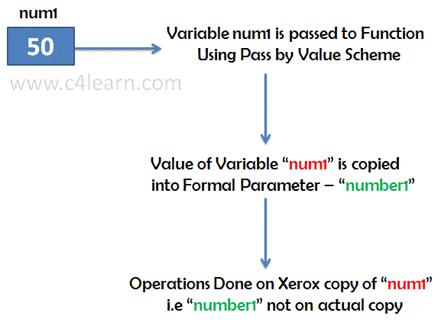

Slide 19
Call by Refrence
#include<stdio.h>
void interchange(int *num1,int *num2)
{
int temp;
temp = *num1;
*num1 = *num2;
*num2 = temp;
}
int main() {
int num1=50,num2=70;
interchange(&num1,&num2);
printf("\nNumber 1 : %d",num1);
printf("\nNumber 2 : %d",num2);
return(0);
}

Slide 20
While passing parameter using call by address scheme , we are passing the actual address of the variable to the called function.
Any updates made inside the called function will modify the original copy since we are directly modifying the content of the exact memory location.

Slide 21
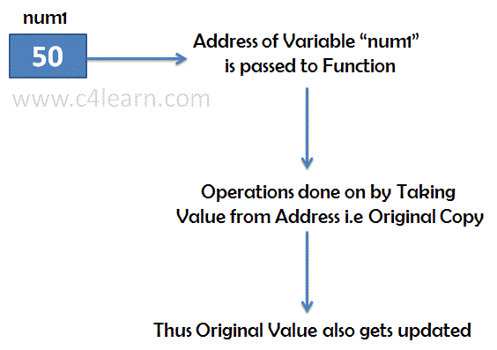

Slide 22
Point | Call by Value | Call by Reference
Copy | Duplicate Copy of Original Parameter is Passed | Actual Copy of Original Parameter is Passed
Modification | No effect on Original Parameter after modifying parameter in function | Original Parameter gets affected if value of parameter changed inside function

Slide 23
Command line argument
it is possible to pass some values from the command line to your C programs when they are executed. These values are called command line arguments and many times they are important for your program especially when you want to control your program from outside instead of hard coding those values inside the code.
The command line arguments are handled using main() function arguments where argc refers to the number of arguments passed, and argv[] is a pointer array which points to each argument passed to the program. Following is a simple example which checks if there is any argument supplied from the command line and take action accordingly −

Slide 24
#include <stdio.h>
int main( int argc, char *argv[] ) {
if( argc == 2 ) {
printf("The argument supplied is %s\n", argv[1]);
}
else if( argc > 2 ) {
printf("Too many arguments supplied.\n");
}
else {
printf("One argument expected.\n");
}
}

Slide 25
When the above code is compiled and executed with single argument, it produces the following result.
$./a.out testing
The argument supplied is testing
When the above code is compiled and executed with a two arguments, it produces the following result.
$./a.out testing1 testing2
Too many arguments supplied.
When the above code is compiled and executed without passing any argument, it produces the following result.
$./a.out
One argument expected

Slide 26
#include <stdio.h>
int main( int argc, char *argv[] ) {
printf("Program name %s\n", argv[0]);
if( argc == 2 ) {
printf("The argument supplied is %s\n", argv[1]);
}
else if( argc > 2 ) {
printf("Too many arguments supplied.\n");
}
else {
printf("One argument expected.\n");
}
}

Slide 27
Recursive Function
Recursion is the process of repeating items in a self-similar way. In programming languages, if a program allows you to call a function inside the same function, then it is called a recursive call of the function.

Slide 28
void recursion() {
recursion(); /* function calls itself */
}
int main() {
recursion();
}

Slide 29
The C programming language supports recursion, i.e., a function to call itself. But while using recursion, programmers need to be careful to define an exit condition from the function, otherwise it will go into an infinite loop.
Recursive functions are very useful to solve many mathematical problems, such as calculating the factorial of a number, generating Fibonacci series, etc.
Number Factorial
The following example calculates the factorial of a given number using a recursive function −

Slide 30
#include <stdio.h>
int factorial(int i) {
if(i <= 1)
{
return 1;
}
return i * factorial(i - 1);
}
int main() {
int i = 5;
printf("Factorial of %d is %d\n", i, factorial(i));
return 0;
}

Slide 31
Storage Classes in C
A storage class defines the scope (visibility) and life-time of variables and/or functions within a C Program. They precede the type that they modify.
Storage class specifiers in C language tells the compiler where to store a variable, how to store the variable, what is the initial value of the variable and life time of the variable.

Slide 32
Types of Storage Classes in C
We have four different storage classes in a C program −
Auto
Extern
static
register

Slide 33
The auto Storage Class
The auto storage class is the default storage class for all local variables.
A variable declared inside a function without any storage class specification, is by default an automatic variable.
They are created when a function is called and are destroyed automatically when the function exits.
Automatic variables can also be called local variables because they are local to a function.
By default they are assigned garbage value by the compiler.

Slide 34
The auto Storage Class
void main()
{
int number;
or
auto int number; //Both are same
}

Slide 35
The extern Storage Class
The extern keyword is used before a variable to inform the compiler that this variable is declared somewhere else.
The default value for extern variable is zero.

Slide 36
The extern Storage Class
#include<stdio.h>
int x = 10 ; //global variable
int y = 50; //global variable
int main( )
{
extern int x;
extern int y;
printf("The value of x is %d \n",x);
printf("The value of y is %d",y);
return 0;
}

Slide 37
Output
The value of x is 10
The value of y is 50

Slide 38
The static Storage Class
The static storage class instructs the compiler to keep a local variable in existence during the life-time of the program instead of creating and destroying it each time it comes into and goes out of scope.
The static modifier may also be applied to global variables. When this is done, it causes that variable's scope to be restricted to the file in which it is declared.
The default value for static variables is zero.

Slide 39
The static Storage Class
#include<stdio.h>
void test();
int main()
{
test();
test();
test();
}
void test()
{
static int a ;
a = a+1;
printf("a=%d \t",a);
}

Slide 40
Output
a=1 a=2 a=3

Slide 41
The register Storage Class
The register storage class is used to define local variables that should be stored in a register instead of RAM.
It should also be noted that defining 'register' does not mean that the variable will be stored in a register. It means that it MIGHT be stored in a register depending on hardware and implementation restrictions.

Slide 42
The register Storage Class
Usually few variables which are to be accessed very frequently in a program are declared with the register keyword which improves the running time of the program.
An important point to be noted here is that we cannot obtain the address of a register variable using pointers.
Example:-
register int number;

Slide 43
Summary of Storage Classes
S. No. | Storage Specifier | Storage place | Initial / default value | Scope | Life
1 | auto | CPU Memory | Garbage value | local | Within the function only.
2 | extern | CPU memory | Zero | Global | Till the end of the main program. Variable definition might be anywhere in the C program
3 | static | CPU memory | Zero | local | Retains the value of the variable between different function calls.
4 | register | Register memory | Garbage value | local | Within the function

Slide 44
goto statement in C
A goto statement in C programming provides an unconditional jump from the 'goto' to a labeled statement in the same function.
NOTE − Use of goto statement is highly discouraged in any programming language because it makes difficult to trace the control flow of a program, making the program hard to understand and hard to modify.

Slide 45
goto statement in C
The syntax for a goto statement in C is as follows −
goto label;
..
.
label: statement;
Here label can be any plain text except C keyword and it can be set anywhere in the C program above or below to goto statement.

Slide 46
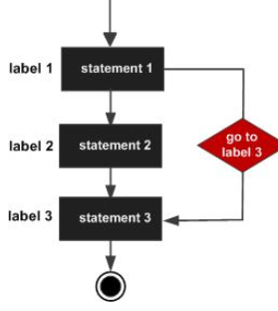
Flow Diagram for goto statement in C

Slide 47
Example
int main()
{
int age;
Vote: printf("you are eligible for voting");
NoVote: printf("you are not eligible to vote");
printf("Enter you age:");
scanf("%d", &age);
if(age>=18)
goto Vote;
else
goto NoVote;
return 0; }

Slide 48
Example
#include <stdio.h>
int main ()
{
int a = 10;
LOOP: do {
if( a = = 15)
{
a = a + 1;
goto LOOP;
}
printf("value of a: %d\n", a);
a++;
}while( a < 20 );
return 0;
}

Slide 49
Output
value of a: 10
value of a: 11
value of a: 12
value of a: 13
value of a: 14
value of a: 16
value of a: 17
value of a: 18
value of a: 19

